Slide 1
PI Meeting Response – Gallup Homework
DARPA ASKE – Phase II Kickoff Meeting
May 24, 2019
Notes:
Thanks. So, I want to start by briefly reviewing our system, MULTIVAC, and progress to date, as I think it differs from some of the other projects in this same group in important ways.

Slide 2
Breakout Session 1 – Gallup Notes
Extraction, Curation, and (though not specifically covered in this session) Inference are all essential components/steps in any kind of combined ASKE program solution.
These steps are generally sequential, but also have iterative loops (curation/inference returning to extraction/curation for refinement or updating of knowledge stores, e.g.)
These steps are not strictly differentiated from each other. Overall, for any scientific knowledge extraction/inference task the “work” will be distributed over these components in some way. Each component can be defined in various ways that takes on or pushes off to other components more of that work.
Examples: Basic “vacuum” style extraction with little or no specificity on data or sources types or provenance requires much more sophisticated curation strategies. Similarly, if those curation strategies are not in fact very sophisticated a great deal of work needs to be done at the inference level to make use of the curated knowledge.
Example: Using a PGM system for curation embeds a lot of relational knowledge and meaning into the curated knowledge base, whereas more compartmentalized stores (like a series of relational databases) assumes less about the interrelations of the data and requires the inference level to discover that if it is important.
Different extract and curation strategies imply different ultimate inference/inquiry goals.
Extraction strategies specific to data types (text, tabular data, code, graphics, etc.) assume that the end-user or downstream systems want those data types and only those data types.
Similarly, curation strategies involving PGMs assume that global relationships in the data are important for inference tasks.
Ultimately, given the diversity of scientific inquiry tasks potentially being modeled or augmented, it may be useful to think of each of these components or levels as defined by standard APIs.
Each component would have a set of potential streams of information that the other components could query.
Depending on the individual design/purpose of a system, a subset of those potential streams would be “active” for any component.
Other components could then adapt to recognize the types of information that component is providing/requiring.
Notes:
Going back to our initial stated objectives, we set out to design a system that, given a particular domain, absorbs the scientific knowledge and concepts from the domain literature, compiles this knowledge into a graphical model knowledge base - specifically a Markov logic network - and learns to query that ontology in a programmatic way.
In Phase I, we built a bootstrap version of such a system using epidemiology as our test domain.
From that system, we have begun building a training dataset of scientific queries that we will use in Phase II to teach a generative adversarial network (or GAN) system how to form new scientific queries within this domain that have not been - or might not ever be - asked by human researchers.
Two key principles guided this design:
* domain agnostic, to be as generalizable as possible
* unsupervised learning, to avoid the need for detailed labeling efforts or prior work

Slide 3
Breakout Session 2 – Gallup Notes
Ultimately there are two basic types of HMI that ASKE systems must define:
Inquiry submissions (how do end-users input into the system to engage it to help solve their problems?)
Output of results (how does the system provide end-users with information that solves their problems?)
It may be much easier to find common/standard approaches to inputting inquiries into the system, and many types of approaches exist more or less off the shelf now:
Siri-style speech recognition
…
Web-forms, etc.
Standardizing on outputs may be much more difficult
Ideal outputs may be very domain specific
Ideal outputs may be very task specific
A system capable of providing ideal outputs that covers all (or even most) potential domains and tasks (if defining that set is even tractable itself) would be very complex
This last point may argue again for an “API definitions” approach to a combined ASKE program solution.
Ultimately, it may be much more practical to agree on a set of standard architectures and/or output types at the extraction/curation/inference levels and allow the HMI solutions to be many and varied, governed by a common API that they can plug.
We could form working groups around extraction, curation, and inference levels to define the essential and the potential inputs and outputs for each level in more formal ways. These groups could be mandated to define APIs for each level, to allow a variety of architectures and approaches to live at each level and still usefully interoperate.
Notes:
Going back to our initial stated objectives, we set out to design a system that, given a particular domain, absorbs the scientific knowledge and concepts from the domain literature, compiles this knowledge into a graphical model knowledge base - specifically a Markov logic network - and learns to query that ontology in a programmatic way.
In Phase I, we built a bootstrap version of such a system using epidemiology as our test domain.
From that system, we have begun building a training dataset of scientific queries that we will use in Phase II to teach a generative adversarial network (or GAN) system how to form new scientific queries within this domain that have not been - or might not ever be - asked by human researchers.
Two key principles guided this design:
* domain agnostic, to be as generalizable as possible
* unsupervised learning, to avoid the need for detailed labeling efforts or prior work

Slide 4
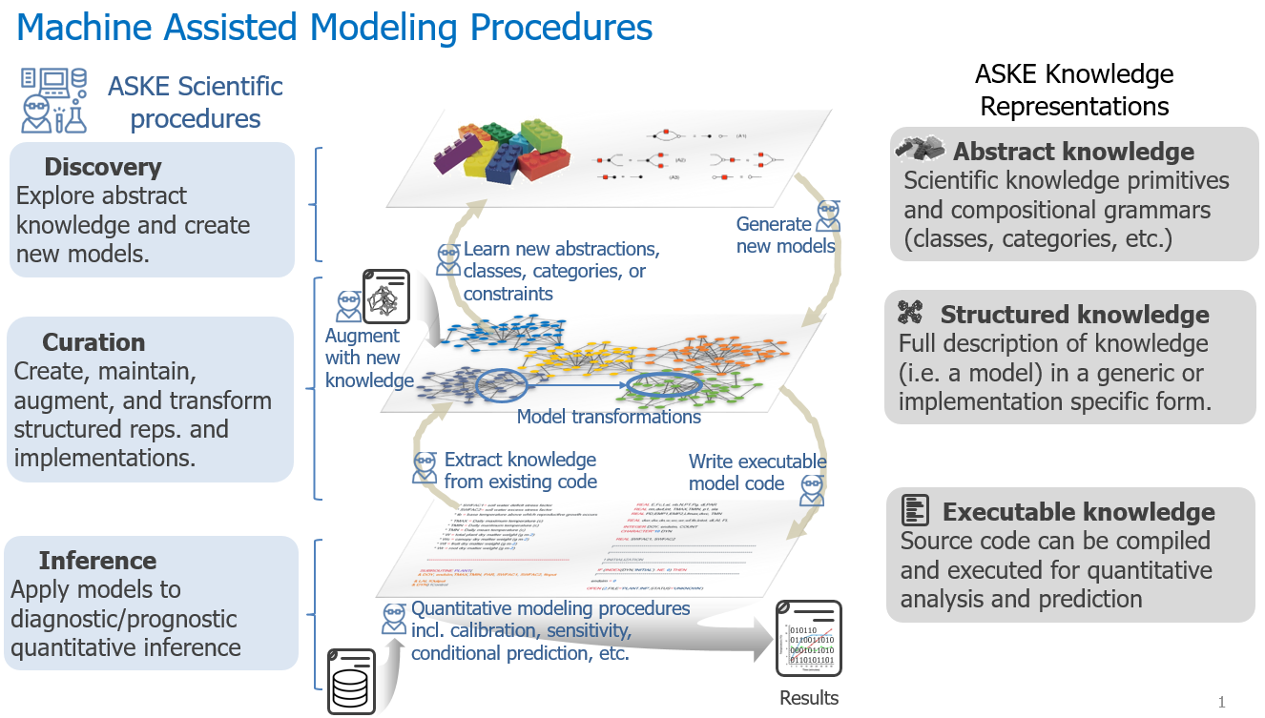
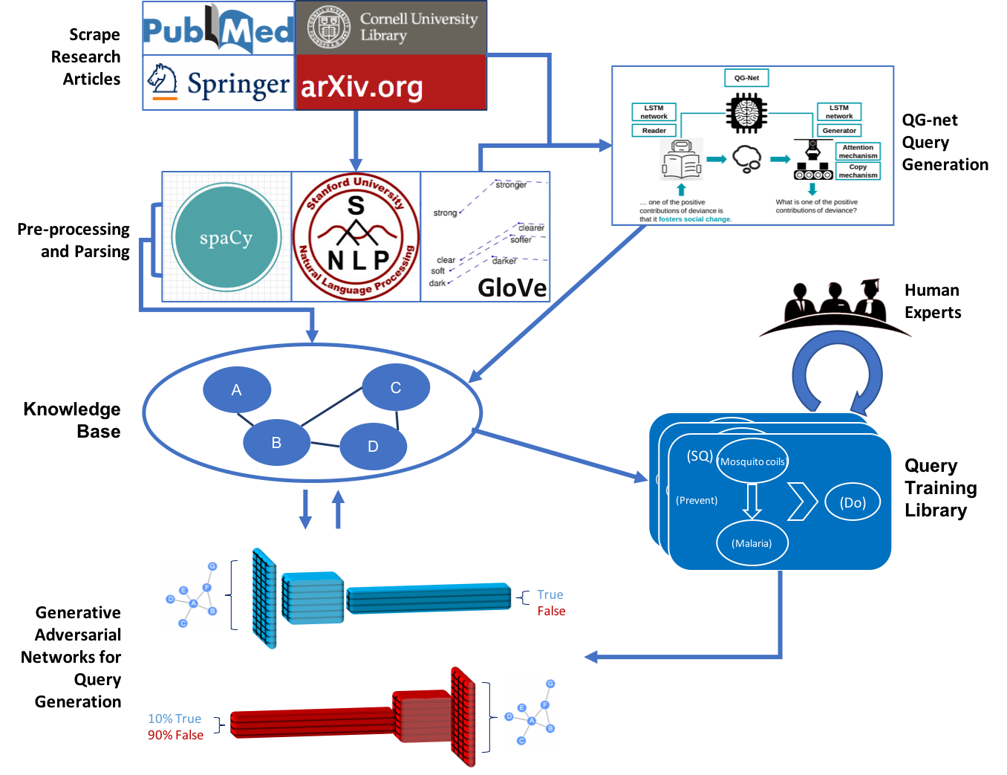
Schematics
Extraction
(NLP)
Curation
(MLN)
Inverted Inference (GAN)
MULTIVAC Architecture and Workflow

Slide 5
Gallup MULTIVAC in ASKE Context
Gallup’s MULTIVAC system extracts scientific knowledge — in the form of facts, relationships, equations — from a given domain corpus consisting of natural language text and formal mathematical equations. The system then compiles this knowledge into a curated probabilistic graphical model (specifically, a Markov Logic Network) knowledgebase. Finally, the system learns to query that knowledgebase in order to accelerate scientific exploration within the target domain.
With reference to the first ASKE program schematic on the previous slide, MULTIVAC is more or less vertically integrated across the discovery/extraction, curation, and inference.
The end objective, however, is hypothesis generation. This feature situates the most novel contribution of MULTIVAC essentially outside these levels, at the top of the more process-oriented second schematic on the previous slide. In effect, MULTIVAC’s “inference” component inverts the standard intention and, instead of using the work done in the extraction and curation layers to arrive at new inferences, learns through observation and experimentation how to ask it’s own novel questions that then require more standard inference solutions to answer.
The final goal of a MULTIVAC system for any given domain is to generate new scientific queries relevant to that domain that have not been asked before by humans. These inquiries, properly formatted, could in theory even act as inputs to many of the other TA2 systems.

Slide 6
ASKE Use Case Examples
Modernizing and consolidating old research:
While much research is available in digital form today, vast archives exist in hard copy in various forms that are far less searchable. Using an ASKE system to ingest and compile/curate these types of repositories could help revitalize forgotten areas of research.
Breaking stovepipes:
Sometimes research fields become balkanized between different communities based on approaches, terminologies, or simply favored publication venues. An ASKE system that can comprehend a field at scale across these artificial segmentations could help break irrational logjams and cross-pollinate discoveries.
Revitalizing stagnant areas of research:
Occasionally research fields lose momentum or interest, as consensus emerges on “big questions” or as unknowns become more apparently “unknowable.” Paradigm shifts can happen that help break this stagnation and revolutionize fields, but this can take a great deal of time and is never guaranteed. A system that can analyze a field of research and produce novel questions or avenues of inquiry can help inject new creativity and perspectives and revitalize research.

